Slide 1
SECURE DATA HIDING IN IMAGES USING STEGNOGRAPHY
CAPSTONE PROJECT
Presented By:
Student Name : Lalitha Shivapriya Sriramoju
College Name & Department : Sri Venkateshwara Engineering college & Computer Science and Engineering

Slide 2
OUTLINE
Problem Statement
Technology used
Wow factor
End users
Result
Conclusion
Git-hub Link
Future scope

Slide 3
Problem Statement
With the rise of digital communication, ensuring data security and confidentiality is crucial. Traditional encryption methods make hidden data obvious, attracting unwanted attention. Steganography offers a solution by embedding secret information within images, making detection difficult. This project focuses on implementing image-based steganography to securely hide and retrieve data without altering the image’s perceptible quality.

Slide 4
Technology used
Libraries: NumPy, CV2
Technologies used: Steganography

Slide 5
Wow factors
Lossless Image Encryption – Uses PNG format to prevent pixel distortion from compression, ensuring accurate decryption.
Dynamic Pixel Encoding – Encrypts data by modifying pixel values in a distributed manner, reducing the chances of detection.
Passcode-Based Security – Adds an authentication layer, preventing unauthorized access to the hidden data.
Cross-Platform Compatibility – Works seamlessly on different operating systems without requiring specialized software.
Customizable Message Length – Allows encoding of variable-length messages while preserving the original image quality.
Fast & Efficient Retrieval – Decryption is optimized for quick extraction with minimal processing overhead.

Slide 6
End users
Cybersecurity Professionals – To securely transmit confidential data without attracting attention.
Journalists & Activists – To discreetly share sensitive information in high-surveillance environments.
Government & Military Agencies – For covert communication and intelligence data protection.
Corporations & Businesses – To protect trade secrets, sensitive documents, and confidential messages.
Forensic Investigators – To securely embed and transfer crucial evidence in digital forensics.
General Users & Privacy Enthusiasts – For personal data protection and secure messaging in everyday communication.

Slide 7
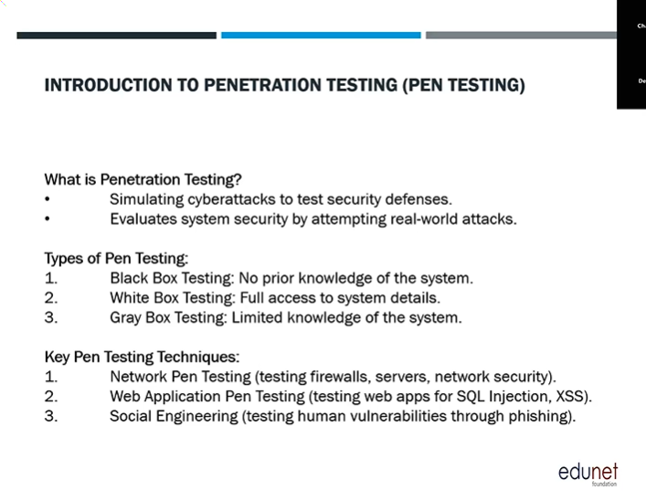
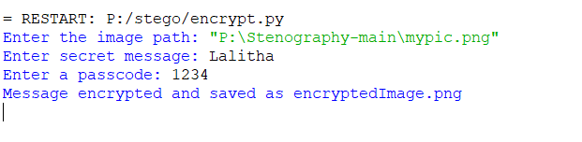
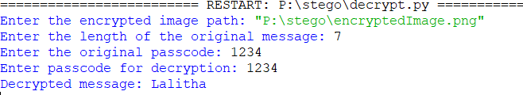
Results
Encrypted Image

Slide 8
Conclusion
This project successfully implements image-based steganography to securely hide and retrieve data while maintaining the original image’s visual integrity. By leveraging lossless encryption, passcode-based security, and dynamic pixel encoding, it ensures confidential communication without attracting suspicion. Compared to traditional encryption, this method provides an added layer of undetectability, making it suitable for secure messaging, cybersecurity, and digital forensics. Ultimately, this project addresses the growing need for covert data transmission, offering a reliable, efficient, and secure solution for modern digital communication.

Slide 9
GitHub Link
https://github.com/shivapriya032005/stegoProject_aicte.git

Slide 10
Future scope(optional)
Enhanced Security with Cryptographic Encryption – Integrating AES or RSA encryption before embedding data for added protection.
Support for Multiple File Types – Expanding beyond text to hide documents, audio, or even other images within an image.
AI-Based Steganalysis Resistance – Implementing machine learning techniques to counter AI-based detection methods.
Adaptive Encoding for Higher Capacity – Using advanced pixel modulation to store more data without noticeable changes in image quality.
Real-Time Steganography in Videos – Extending the technique to video frames, enabling secure streaming of hidden data.
Cloud-Based Secure Communication – Developing a web-based or mobile steganography tool for easy and secure remote data sharing.

Slide 11
THANK YOU

